Slide 1
GALOIS THEORY AND ROOTS OF FIFTH DEGREE POLYNOMIALS
SHANAY SHAH
FIFTH YEAR UNDERGRADUATE

Slide 2
Notation
N : The set of natural numbers
Z : The set of integers
Q : The set of rational numbers
R : The set of real numbers
C: The set of complex numbers

Slide 3
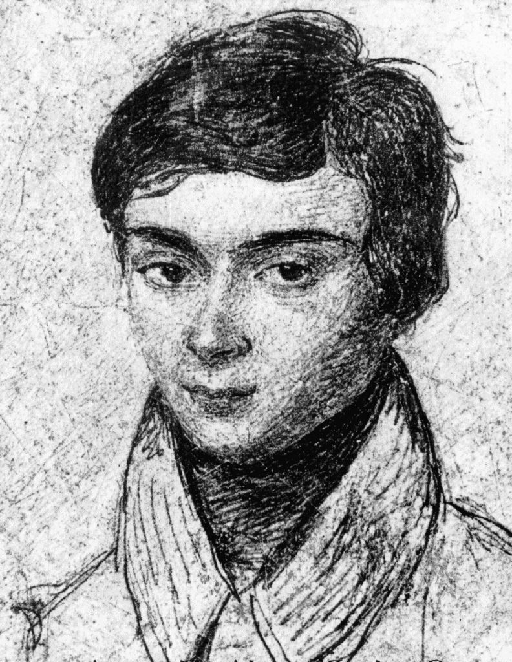
Evariste Galois

Slide 4
The path ahead
1) First, prove that the Galois group of any radical field extension is solvable.
2) Next, you prove that the group S₅ is not solvable.
3) Next, prove that every degree n polynomial generates a Galois group
which is a sub-group of S_{n}. 4) Finally, you find a 5th degree polynomial p(x) whose Galois group is S₅.
The splitting field of this polynomial cannot be a radical field extension
because all radical field extensions have solvable Galois groups.
So the roots of p(x) cannot be built up from +, −, ×, / and the n^{th} roots.
Hence no formula.

Slide 5
Some examples of groups
Cyclic group
Symmetric group: {group of permutations}
Automorphisms

Slide 6
The path ahead
1) First, prove that the Galois group of any radical field extension is solvable.
2) Next, you prove that the group S₅ is not solvable.
3) Every degree n polynomial generates a Galois group which is a sub-group of S_{n}. 4) Finally, you find a 5th degree polynomial p(x) whose Galois group is S₅.
Suppose the splitting field of this polynomial is a radical field extension, then
its Galois group is solvable. However S₅ is not solvable.
So the roots of p(x) cannot be built up from +, −, ×, / and the n^{th} roots.
Hence no formula.

Slide 7
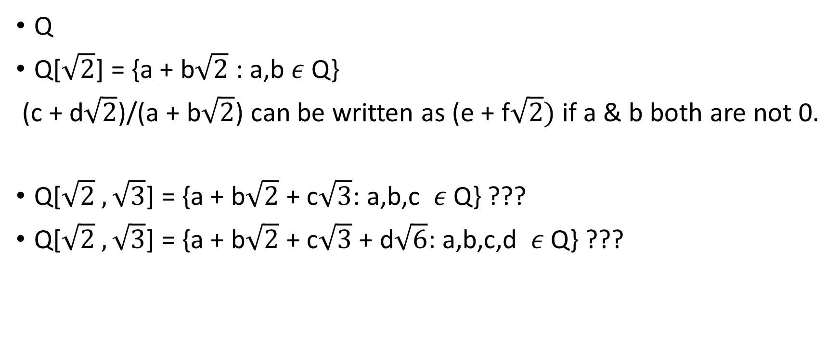
Some examples of fields
Q
Q[$\sqrt{2}$] = {a + b$\sqrt{2}$ : a,b $ε$ Q}
(c + d$\sqrt{2}$)/(a + b$\sqrt{2}$) can be written as (e + f$\sqrt{2})$ if a & b both are not 0.
Q[$\sqrt{2} ,\sqrt{3}$] = {a + b$\sqrt{2}$ + c$\sqrt{3}$: a,b,c $ε$Q} ???
Q[$\sqrt{2} ,\sqrt{3}$] = {a + b$\sqrt{2}$ + c$\sqrt{3}$ + d$\sqrt{6}$: a,b,c,d $ε$Q} ???

Slide 8
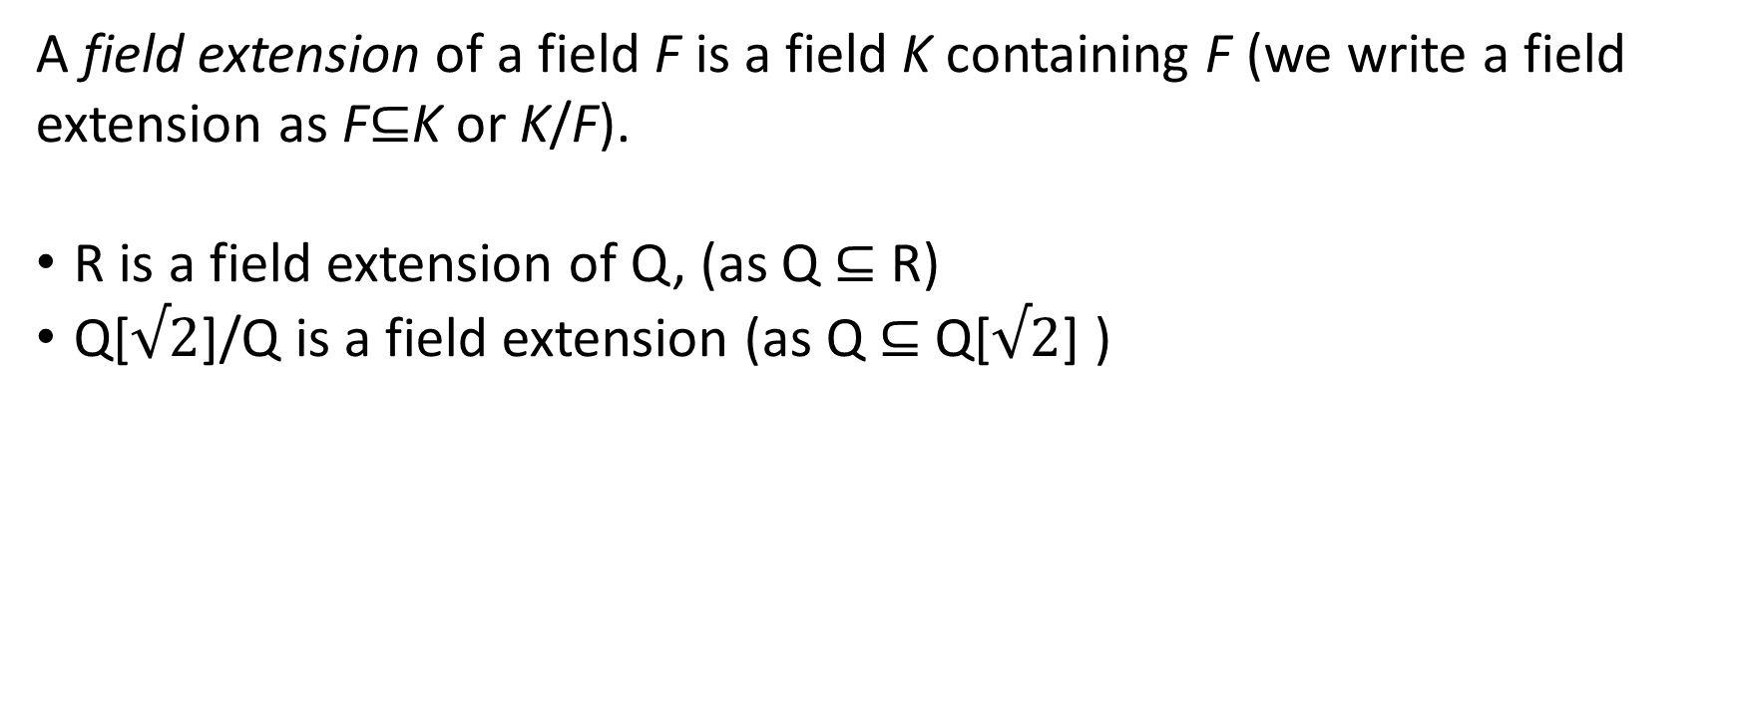
Field extensions
A field extension of a field F is a field K containing F (we write a field extension as F⊆K or K/F).
R is a field extension of Q, (as Q ⊆ R)
Q[$√2$]/Q is a field extension (as Q ⊆ Q[$√2$] )

Slide 9
Cyclotomic field extensions
First, you define a cyclotomic field extension to be a field extension of F
where you take an element x in F and add the n^{th} root.
So, Q[√2] is a cyclotomic field extension of Q.

Slide 10
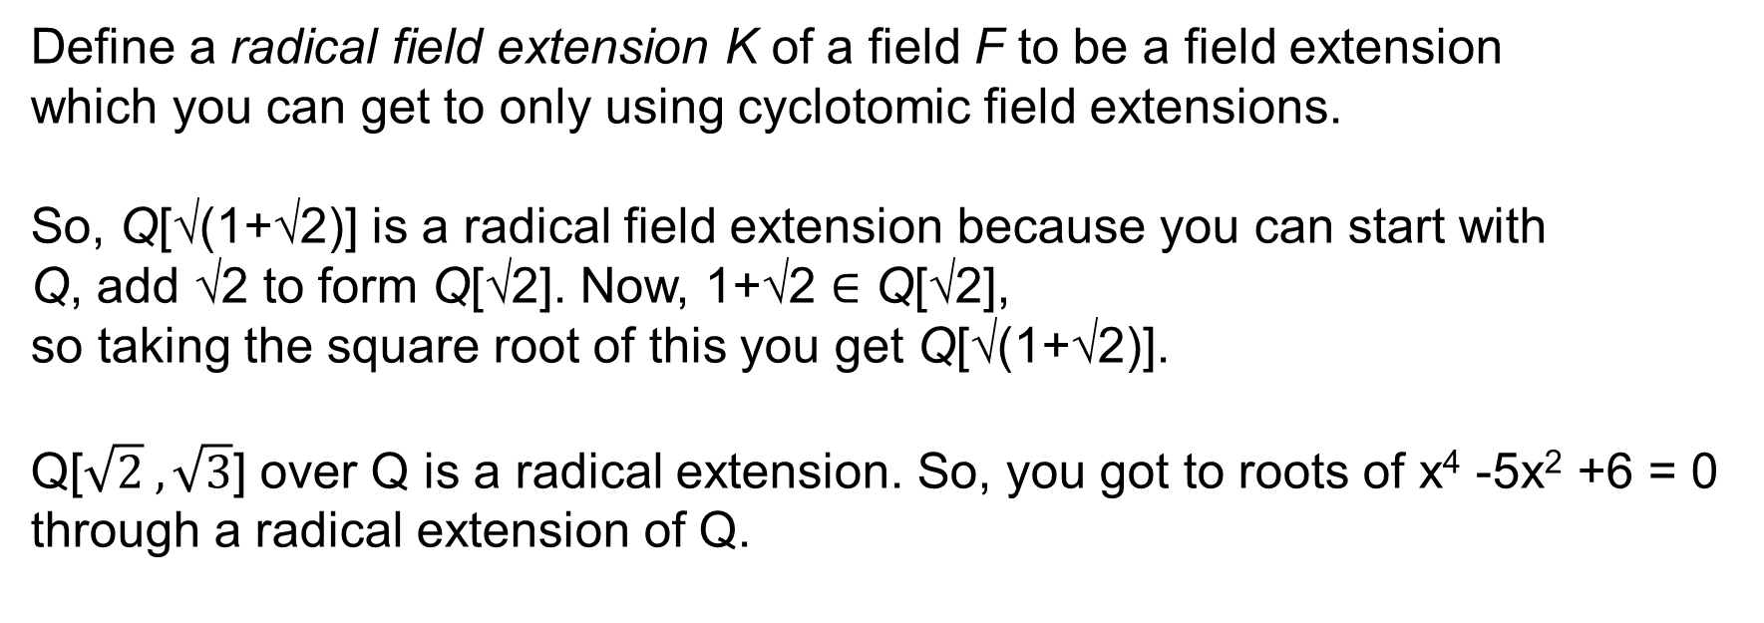
Radical field extensions
Define a radical field extension K of a field F to be a field extension
which you can get to only using cyclotomic field extensions.
So, Q[√(1+√2)] is a radical field extension because you can start with
Q, add √2 to form Q[√2]. Now, 1+√2 $∈$ Q[√2],
so taking the square root of this you get Q[√(1+√2)].
Q[$\sqrt{2} ,\sqrt{3}$] over Q is a radical extension. So, you got to roots of x⁴ -5x² +6 = 0
through a radical extension of Q.

Slide 11
The path
1) First, prove that the Galois group of any radical field extension is solvable.
2) Next, you prove that the group S₅ is not solvable.
3) Next, prove that every degree n polynomial generates a Galois group
which is a sub-group of S_{n}. 4) Finally, you find a 5th degree polynomial p(x) whose Galois group is S₅.
The splitting field of this polynomial cannot be a radical field extension
because all radical field extensions have solvable Galois groups.
So the roots of p(x) cannot be built up from +, −, ×, / and the n^{th} roots.
Hence no formula.

Slide 12
Splitting fields
Given a polynomial p(x) we have what is called the splitting field of p(x)
which is the smallest field extension of Q that contains all the roots of p(x).
So, if p(x) = x²−2 then the splitting field of p(x) is Q[√2]
(it contains all the roots of p(x) and if it had fewer elements
it either wouldn't contain all the roots or wouldn't be a field).
Similarly, the splitting field of q(x) = x⁴ – 5x² + 6 is Q[√2 ,√3]
f(x) ∈ F[x] is Solvable by Radicals if it has a splitting field E such that
E/F forms a radical extension.

Slide 13
The path
1) First, prove that the Galois group of any radical field extension is solvable.
2) Next, you prove that the group S₅ is not solvable.
3) Next, prove that every degree n polynomial generates a Galois group
which is a sub-group of S_{n}. 4) Finally, you find a 5th degree polynomial p(x) whose Galois group is S₅.
The splitting field of this polynomial cannot be a radical field extension
because all radical field extensions have solvable Galois groups.
So the roots of p(x) cannot be built up from +, −, ×, / and the n^{th} roots.
Hence no formula.

Slide 14
Field automorphism
A field automorphism f has to be an invertible function such that
f(x+y)=f(x)+f(y),
f(ax)=f(a)f(x)
and f(1/x)=1/f(x).
Eg. f : (a + b√2) (a - b√2) is an automorphism. It can equivalently be defined as
f which is an automorphism fixes Q and takes √2 to - √2 (permutes roots).
But permutation doesn’t always give automorphisms.

Slide 15
F-automorphism
More specifically, if we have a field extension K of a field F,
then an F-automorphism of K is an automorphism f of K
with the additional property that f(x)=x for all x in F.
Eg. The previous f was a Q-automorphism.

Slide 16
Galois group
If we have a field F which is a field extension of Q, then we have a
collection G of Q-automorphisms of F.
This collection G is a group with the operation defined by composition:
if f and g are in G, i.e. they are Q-automorphisms of F,
then f⋅g is a Q-automorphism defined by (f⋅g)(x)=f(g(x)).
It is called the Galois group of the field extension F over Q,
usually written Gal(F/Q).
If F is the splitting field of a polynomial p(x),
then G is called the Galois group of the polynomial p(x), written Gal(p).

Slide 17
The path
1) First, prove that the Galois group of any radical field extension is solvable.
2) Next, you prove that the group S₅ is not solvable.
3) Next, prove that every degree n polynomial generates a Galois group
which is a sub-group of S_{n}. 4) Finally, you find a 5th degree polynomial p(x) whose Galois group is S₅.
The splitting field of this polynomial cannot be a radical field extension
because all radical field extensions have solvable Galois groups.
So the roots of p(x) cannot be built up from +, −, ×, / and the n^{th} roots.
Hence no formula.

Slide 18
Solvable group
A group G that has a series of normal subgroups {e} = H₀ ◁ H₁ ◁ ··· ◁ H_{n-1} ◁ H_{n} = G where for each 0 ≤ i ≤ n, H_{i+1}/H_{i} is Abelian
Abelian Groups are solvable
Non-Abelian and simple Groups are not solvable
(Simple: A group with no proper, non-trivial normal subgroup)
Subgroups of solvable groups are also solvable
If Gal(E/F) is not solvable, then f(x) is not solvable by radicals.

Slide 19
Solvable groups
S₁, S₂, S₃, S₄ are solvable.
Hence, all subgroups of S₁, S₂, S₃, S₄ are solvable.
A₅, a sub-group of S₅, is non abelian and simple, hence not solvable.
Hence, S₅ is not solvable.
n^{th} degree polynomials give Galois groups which are sub-groups of S_{n}.
Hence, we can only hope to find “polynomials with no formula for roots” when the degree is 5 or more.

Slide 20
The path
1) First, prove that the Galois group of any radical field extension is solvable.
2) Next, you prove that the group S₅ is not solvable.
3) Next, prove that every degree n polynomial generates a Galois group
which is a sub-group of S_{n}. 4) Finally, you find a 5th degree polynomial p(x) whose Galois group is S₅.
The splitting field of this polynomial cannot be a radical field extension
because all radical field extensions have solvable Galois groups.
So the roots of p(x) cannot be built up from +, −, ×, / and the n^{th} roots.
Hence no formula.

Slide 21
Theorem
If f(x) is irreducible in F[x] and E is a splitting field of f(x),
Φ∈Gal(E/F) permutes the roots of f(x)
If a_{i} is a root of f(x), then
f(a_{i}) = Φ (f(a_{i}))
= 0 because 0 is fixed by Φ
= f(Φ(a_{i})) Operation Preserving
But since a_{i} ∉ F, it is not necessarily fixed
If f(x) ∈ F[x] has degree n, then Gal(E/F) is isomorphic to a subgroup of S_{n}
(E being a splitting field of F)

Slide 22
Example
Consider E = ℚ(ω,³√2) where ω = -1+i√3
2
Then the elements of Gal(E/ℚ) are described as follows:
e | α | β | β² | αβ | αβ²
ω→ω | ω→ω² | ω→ω | ω→ω | ω→ω² | ω→ω²
³√2→³√2 | ³√2→³√2 | ³√2→ω · ³√2 | ³√2→ω² · ³√2 | ³√2→ω² · ³√2 | ³√2→ω · ³√2
Note: Gal(E/ ℚ ) is not Abelian. αβ ≠ βα

Slide 23
Lattices
Subgroups of Gal(E/ ℚ)
{e, α, β, β², αβ, αβ²}
2 3 3 3
{e, β, β²} {e, α} {e, αβ} {e, αβ²}
3 2 2 2
{e}
E = ℚ (ω,³√2)
Subfields of E
3 2 2 2
ℚ (ω)
ℚ (³√2)
ℚ (ω · ³√2)
ℚ (ω² · ³√2)
2 3 3 3
ℚ

Slide 24
Fundamental Theorem of Galois Theory
Given E, a splitting field over F, F being finite or with character 0
For every subfield K of E containing F
There is a subgroup Gal(E/K) of Gal(E/F), and
[E:K] = |Gal(E/K)| and [K:F] = |Gal(E/F)| / |Gal(E/K)|
If K is a splitting field of some f(x)∈F[x] then Gal(E/K) ◁ Gal(E/F)
and |Gal(K/F)| = |Gal(E/F)| / |Gal(E/K)|
K = E_{Gal(E/K)}
For H ≤ Gal(E/F), H = Gal(E/E_{H})

Slide 25
Lots of “can be proved that…”
What about 6th degree polynomials?
Like we assumed i to be a root of x² + 1 = 0, can we assume a new symbol which will help us make a formula for all roots?

Slide 26

Other problems based on fields
Construction problems: n-sided polygon, trisecting an angle, $\sqrt[3]{2}$, $π$
Some application in ECC
Some applications in Quantum mechanics too

Slide 27
References
http://nrich.maths.org/1422
11 pollard
http://www.math.uconn.edu/~kconrad/blurbs/galoistheory/galoisaspermgp.pdf
http://www.jmilne.org/math/CourseNotes/FT.pdf
http://www.math.tifr.res.in/~publ/pamphlets/galoistheory.pdf
http://www.math.uiuc.edu/~r-ash/Algebra/Chapter6.pdf
MA 414(closest course which runs in insti)

Slide 28
Any Questions?

Slide 29
THANK YOU

Slide 30
Backup slides

Slide 31
Intermediate steps

Slide 32
Diagram of bijection between subfields and elements of group

Slide 33
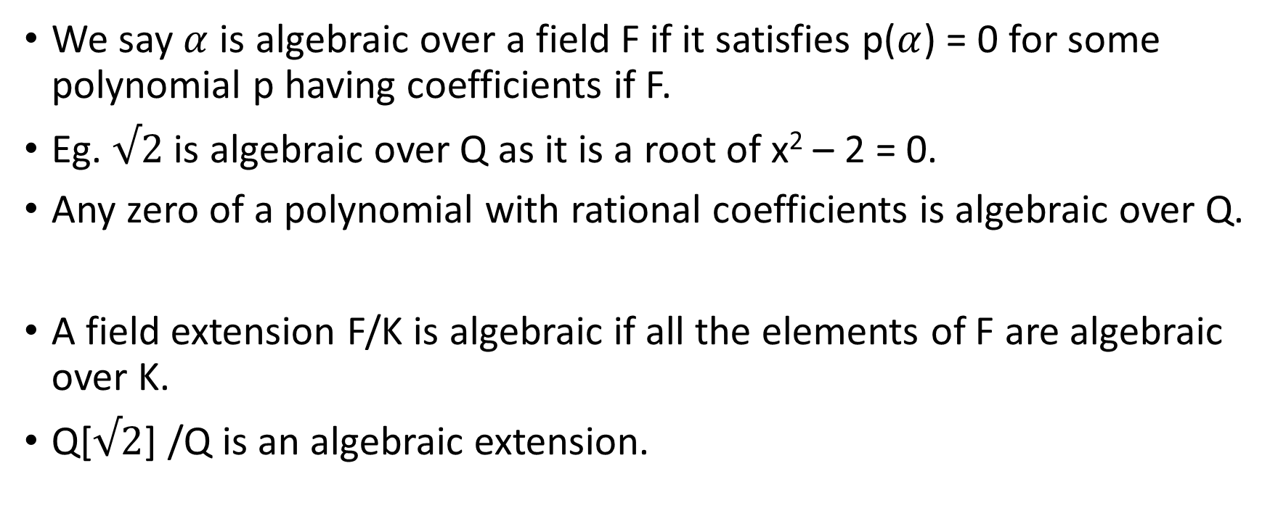
Algebraic extensions
We say $α$ is algebraic over a field F if it satisfies p($α$) = 0 for some polynomial p having coefficients if F.
Eg. $√2$ is algebraic over Q as it is a root of x² – 2 = 0.
Any zero of a polynomial with rational coefficients is algebraic over Q.
A field extension F/K is algebraic if all the elements of F are algebraic over K.
Q[$√2$] /Q is an algebraic extension.

Slide 34
Normal extension

Slide 35
Separable extension

Slide 36
Galois extension

Slide 37
Fundamental theorem of Galois theory

Slide 38
Irreducible polynomial

